Slide 1
Proper Conduct to Provide Excellent Service
Provided by the LAUSD Food Services Division
Notes:
TELL: Hello! Welcome to the Proper Conduct to Provide Excellent Service training. Thank you for joining us.

Slide 2
This training contains language and content that is inappropriate and may make you feel uncomfortable. During the development of this training “No students were harmed.”
Notes:
TELL: This training contains language and content that is inappropriate and may make you feel uncomfortable. During the development of this training “No students were harmed”.

Slide 3
Overview
The District has several policies designed to help employees conduct business honestly and with integrity to effectively serve our customers.
This training will provide an understanding of the following:
Who are the customers
Communication
Employee Code of Ethics
Code of Conduct with Students
“Grace Under Pressure”
Notes:
TELL: The District has several policies designed to help employees conduct business honestly and with integrity. This training will provide an understanding of the following who are the customers and how to professionally communicate to the customers. We will explore the Employee Code of Ethics and the Code of Conduct with Students as posted in district bulletins. These bulletins outline the mission and values of LAUSD and how employees are supposed to approach problems. When you’re faced with a problem “Do not crack under pressure “ instead practice “grace under pressure,” which we will discuss and review later in the presentation.

Slide 4
Objective
To develop the abilities of Food Services employees to interact and serve our most important customers. The goal is to help you develop trust by serving students with respect, responsibility, and propriety.
Notes:
TELL : Our objective is to develop the ability of Food Services employees to interact with students by applying the principles of the Employee Code of Ethics and the Code of Conduct With Students. Our goal is to help develop trust by serving the students with respect, responsibility, and propriety.

Slide 5
Food Services Managers Responsibilities
Food Services Managers are responsible for the following:
Daily operation and management of the cafeteria
Directing food services staff
Ensure customers are satisfied with their Café LA experience
Address any complaints regarding:
Food quality
Customer service
Personnel performance
Notes:
TELL: The Food Services Managers have many responsibilities in the cafeteria. They are responsible for the daily operation and directing food services employees to ensure customers are satisfied with their Café LA experience. Also, they manage the cafeteria to ensure that it is successful and address any complaints regarding food quality. In addition the Food Service Manager must ensure that all employees have been trained on all relevant District Policies and procedures and what their responsibilities are when it comes to providing service to the students we feed.

Slide 6
Who Are Your Customers?
The customer is anyone who buys a product or service.
Our customers include but are not limited to:
Students
Administration
Teachers
Office Staff
Building and Grounds Workers
Food Services Staff
Parents
Notes:
TELL: The customer is anyone who buys a product or service. The Food Services customer’s include students, administration, teachers, office staff, building and grounds workers, food services staff as well as the parents. Our student customers use cash or pin numbers in exchange for food items. In addition adults are able to purchase food items as well.

Slide 7
Student Customers
Food Services provides meals primarily to the students.
The students are our most important clients, but many times we as employees overlook this.
The cafeteria can be hectic, noisy, and at times there is a need to deal with dissatisfied student customers which can be stressful and challenging.
Food Services Employees must always:
Keep their composure
Refrain from getting into an argument or becoming physical with a student
Notes:
TELL: Food Services provides meals primarily to the students. The students are our most important clients, but many times we as employees may overlook this. The cafeteria can be hectic, noisy, and at times there is a need to deal with a dissatisfied student customers which can be stressful and challenging.
The Food Services Employees must always keep their composure and refrain from getting into an argument or becoming physical with students. As a food service employees, we should Smile, be pleasant and kind to our customers at all times. This is key to providing exceptional customer service.

Slide 8
Dissatisfied Students
When dealing with dissatisfied customers practice the following:
Be a good listener
Empathize with the customer
Other people are watching the interaction
Speak slowly and lower your voice
Apologize
Notify your supervisor
Offer a solution and end on a positive note
Know when enough is enough
Set aside your ego
Do not take complaints personally
Notes:
TELL: When dealing with dissatisfied customers practice the following, be a good listener, empathize with the customer, meaning understand what they’re feeling. Keep in mind that other people, such as other students and staff, are watching the interaction. Speak slowly and lower your voice, always apologize, offer a solution, and end the interaction on a positive note. Know when enough is enough, do not let a situation escalate. Set aside your ego and lastly, do not take any complaints personally. If an incident occurs, you must notify your immediate supervisor.

Slide 9
Employee Code Of Ethics
LAUSD’s mission is to educate all students to their maximum potential.
The Code of Ethics is intended to help us achieve success as a District.
Our success depends on our:
Teamwork
Trust
Commitment
Notes:
TELL: LAUSD‘s mission is to educate all students to their maximum potential. Our success depends on our teamwork, trust, and commitment. The Employee Code of Ethics is intended to help us achieve success by setting common expectations and increasing trust, commitment, and teamwork within the District; and between the District and the community.

Slide 10
Code of Conduct With Students Bulletin
Visit http://ethics.lausd.net for more information on Employee Code of Ethics and Code of Conduct with Student publications.
Notes:
TELL: To learn more on the employee code of ethics and the code of conduct with students visit the ethics website http://ethics.lausd.net The bulletins are located under the publication tab. Here is an example of the code of conduct with students bulletin.

Slide 11
Code of Conduct With Students
According to the BUL 5167.0, Code of Conduct with Students, the most important responsibility LAUSD has is the safety of our students.
Employees, as well as all individuals who work with or have contact with students, are reminded that they must:
Be mindful of the fine line drawn between being sensitive to and supportive of students and a possible or perceived breach of responsible or ethical behavior.
Notes:
TELL: According to the BUL 5167.0, Code of Conduct with Students, the most important responsibility LAUSD has is the safety of our students.
All employees, as well as any individual who works with or have contact with students, must be mindful of the fine line drawn between being sensitive to and supportive of students, and a possible or perceived breach of responsible or ethical behavior.

Slide 12
Code of Conduct With Students Cont.
While the District encourages the cultivation of positive relationships with students, employees and all individuals who work with or have contact with students are:
Expected to use good judgement
Cautioned to avoid situations
Including but not limited to the statements found within the Code of Conduct with Students
Notes:
TELL: While the District encourages the cultivation of positive relationships with students, employees and all individuals who work with or have contact with students are expected to use good judgement and are cautioned to avoid situations that may lead them into disciplinary action.
Follow all outlined expectations as indicated in the Code of Conduct with Students bulletin.

Slide 13
Expectations of Employees
The Code of Conduct with Students bulletin has twelve expectations that all employees must follow.
We will be reviewing only three of the twelve expectations that may occur frequently in the cafeteria.
Expectation 3 states employees MAY NOT :
Engage in any behaviors, either directly or indirectly with a student(s) or in the presence of a student(s), that are unprofessional, unethical, illegal, immoral, or exploitative
Notes:
TELL: The Code of Conduct with Students bulletin has twelve expectations that all employees must follow. We will be reviewing only three of the twelve expectations that may occur frequently in the cafeteria. Expectation 3 states employee MAY NOT engage in any behaviors, either directly or indirectly with a student(s) or in the presence of a student(s), that are unprofessional , unethical, illegal, immoral, or exploitative.

Slide 14
Expectations of Employees Cont.
Expectation 5 states employees MAY NOT:
Make statements or comments, either directly or in the presence of a student(s), which are not age appropriate, professional, or which may be considered sexual in nature, harassing, or demeaning
Expectation 6 states employees MAY NOT:
Touch or have physical contact with a student(s) that is not age appropriate or within the scope of the employee's/individual’s responsibilities and/or duties
Notes:
TELL: Continuing on with expectation 5 states employees may not make statements or comments, either directly or in the presence of a student(s), which are not age appropriate, professional, or which may be considered sexual in nature, harassing, or demeaning.
Expectation 6 states employees may not touch or have physical contact with a student(s) that is not age appropriate or within the scope of the employee's/individual’s responsibilities and/or duties.

Slide 15
Scenarios
Let’s take a look at some common scenarios that can occur in the cafeteria between Food Services employees and student customers.
Notes:
TELL: Let’s take a look at some common scenarios that occur in the cafeteria between Food Services employees and student customers.

Slide 16
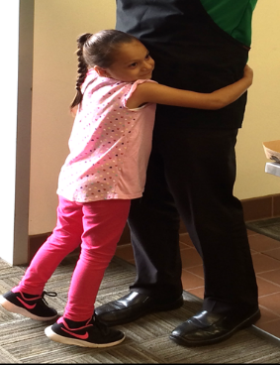
Scenario 1 – A Hug
An elementary student hugs you in the cafeteria while you are serving lunch.
Notes:
TELL: Let’s look at scenario one. An elementary student hugs you in the cafeteria while you are serving lunch. How would you react?

Slide 17
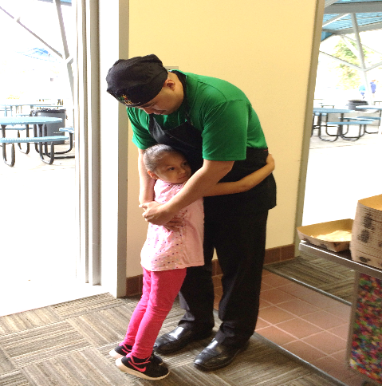
Return The Student’s Embrace
Put your arms around the student to return the hug.
Is this an acceptable action?
Yes
No
Notes:
TELL: The employee should put his/her arms around the student to return the hug. Is this an acceptable action? Click yes or no.

Slide 18
Incorrect
The Food Services Employees may not touch or have physical contact with any student.
Click to continue
Notes:
TELL: Incorrect, the employee may not touch or have physical contact with any student. Click anywhere on the slide to continue.

Slide 19
Correct
Under no condition will Food Services Employees return a hug to a student or give the student a hug.
Click to continue
Notes:
TELL: Correct, under no condition will Food Services Employees return a hug to a student or give the student a hug. Always remember not everyone knows your relationship with the student (whether he or she is your nephew, niece or child) so be consistent with the code of conduct with students. Click anywhere on the slide to continue.

Slide 20
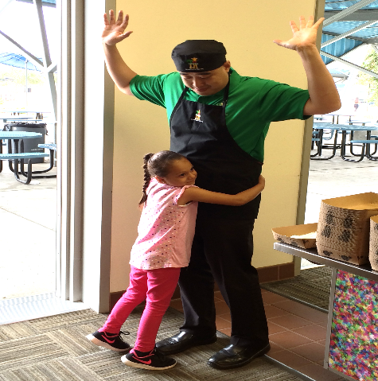
Raise Your Arms
As soon as the student hugs you, raise your arms and hands in the air.
Is this an acceptable action?
Yes
No
Notes:
TELL: Should the employee raise their arms and hands in the air as soon as the students hugs him/her? Is this an acceptable action?
Click yes or no.

Slide 21
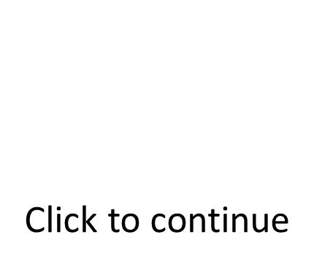
Correct
Food Services Employees will raise their hands and arms in the air. They should then redirect the student back to her meal.
Food Services Employees may not touch or have physical contact with any student.
Notes:
TELL: Correct, the employee will raise their hands and arms in the air. They should then redirect the student back to her meal. Employees may not touch or have physical contact with any student. Click to continue.

Slide 22
Incorrect
Food Services Employees may not touch or have physical contact with any student.
Notes:
TELL: Incorrect, the employees may not touch or have physical contact with any student. Click to continue.

Slide 23
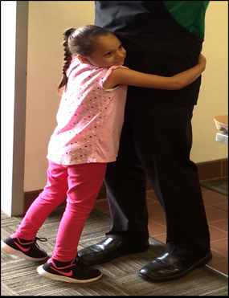
Scenario 2 – Student Approaches for a Hug
A student approaches to hug you in the cafeteria.
Notes:
TELL: Let’s look at scenario 2. From a distance, a student is approaching to hug you in the cafeteria. How would you react?

Slide 24
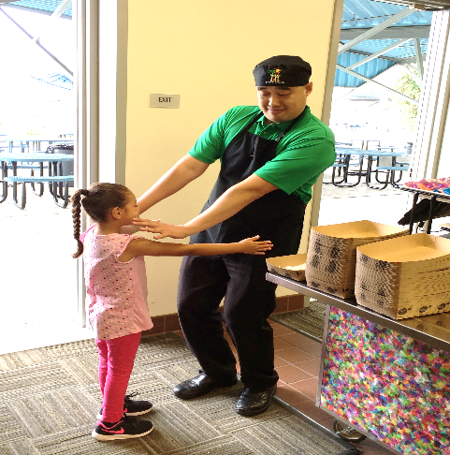
Stop and Put Your Hands Out
As the student is approaching to give you a hug, extend your arms and hands to stop the student. No contact is made.
Is this an acceptable action?
Yes
No
Notes:
TELL: As the student is approaching to give you a hug, could you extend your arms and hands to stop the student. Note that no contact was made.
Is this an acceptable action? Click yes or no.

Slide 25
Incorrect
The Food Services Employees may not touch or have physical contact with any student.
Click to continue
Notes:
TELL: Incorrect, the employees may not touch or have physical contact with any student. Click to continue.

Slide 26
Correct
The employee should motion for the student to slow down and then redirect her to return to her meal.
The employee may not touch or have physical contact with any student.
Click to continue
Notes:
TELL: Correct, the employee should motion for the student to slow down and then redirect her to return to her meal. The employee may not touch or have physical contact with any student. Click to continue.

Slide 27
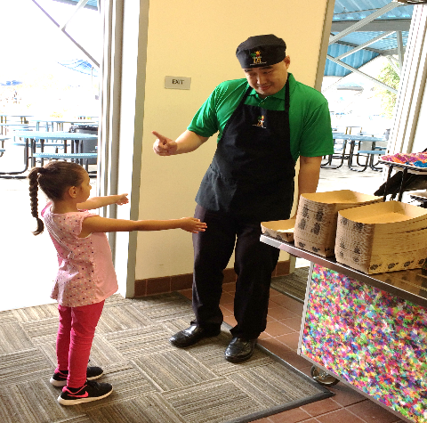
Tell The Student “NO”
Point your finger at the student and in a loud voice say “no sweetie”.
Is this an acceptable action?
Yes
No
Notes:
TELL: Should the employee point a finger at the student and in a LOUD voice say “no honey, amor, baby, or sweetie”?
Is this an acceptable action? Click yes or no.

Slide 28
Incorrect
Food Services Employees MAY NOT make statements or comments that are not age appropriate and professional, or which may be considered sexual harassment in nature, harassing, or demeaning, either indirectly or in the presence of any student.
Notes:
TELL: Incorrect, the employee may not make statements or comments that are not age appropriate and professional, or which may be considered sexual harassment in nature, harassing, or demeaning, either indirectly or in the presence of any student. Click to continue.

Slide 29
Correct
Words of endearment like “sweetie,” “honey,” “kiddo,”etc. should not be used when addressing students, these words are inappropriate. Employees must address students with either a “Mr.” or a “Miss.”
Notes:
TELL: Correct, words of endearment like “sweetie,” “honey,” “kiddo,”etc. should not be used when addressing students, these words are inappropriate. Employees must address students with either a “Mr.” or a “Miss.” Remember, employees may not make statements or comments that are not age appropriate and professional, or which may be considered sexual harassment in nature, harassing, or demeaning, either indirectly or in the presence of any student. Click to continue.

Slide 30
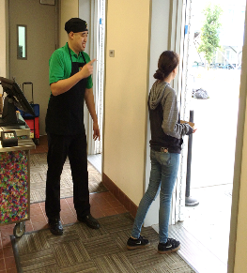
Scenario 3 – POS Interaction
A student walks through the lunch serving line with a burrito and milk. The student passes the POS without a reimbursable meal. The Food Service employee notices this as the student is walking out the door.
Notes:
TELL: Here in Scenario number three, a student walks through the lunch serving line with a burrito and milk. The employee at the POS does not notice that a reimbursable meal has not been selected until the student walks past the POS. How would you react?

Slide 31
Grab The Student’s Arm
Grab the student by the arm as she walks away to get her attention.
Is this an acceptable action?
Yes
No
Notes:
TELL: The employee should grab the student by the arm as she walks away to get her attention. Is this an acceptable action?
Click yes or no.

Slide 32
Incorrect
Food Services Employees may not touch or have physical contact with any student.
Notes:
TELL: Incorrect, the employees may not touch or have physical contact with any student. Click to continue.

Slide 33
Correct
Food Services Employees may not touch or have physical contact with any student.
Notes:
TELL: Correct, the employee may not touch or have physical contact with any student. Click to continue.

Slide 34
Tug The Student’s Clothes
Pull the student by the clothes or hair to get her attention.
Is this an acceptable action?
Yes
No
Notes:
TELL: The employee should pull the student by the clothes or hair to get her attention. Is this an acceptable action? Click yes or no.

Slide 35
Incorrect
Food Services Employees may not touch or have physical contact with any student.
Notes:
TELL: Incorrect, the employees may not touch or have physical contact with any student. Click to continue.

Slide 36
Correct
Food Services Employees may not pull or tug on the students clothes or hair if they are not listening.
Employees may not touch or have physical contact with any student.
Notes:
TELL: Correct, the employee may not pull or tug on the students clothes or hair if they are not listening. The employees may not touch or have physical contact with any student.
Click to continue.

Slide 37
Let The Student Walk Away
Let the student walk away with the non reimbursable meal, despite your efforts to verbally get the student’s attention.
Is this an acceptable action?
Yes
No
Notes:
TELL: Should you let the student walk away with the non reimbursable meal despite your efforts in verbally trying to get the students attention. Is this an acceptable action? Click yes or no.

Slide 38
Correct
The Food Services Employee will let the student walk away with the non reimbursable meal.
Report the incident to the manager after meal service is over and void the sale in CMS.
Notes:
TELL: Correct, the employee will let the student walk away with the non reimbursable meal.
Report the incident to the manager after the meal service is over and void the sale in CMS. Click to continue.

Slide 39
Incorrect
Food Services Employees may not touch, have physical contact with any student.
Notes:
TELL: Incorrect, employees MAY NOT touch, have physical contact with any student. Click to continue.

Slide 40
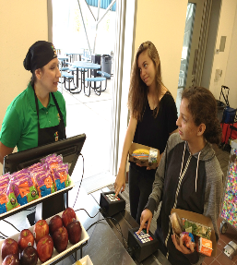
Scenario 4 – Pin Pads
Two students selected reimbursable meals and are at the POS simultaneously entering their pin numbers into the two pin pads. CMS freezes and the student’s names do not appear on the screen, however the students keep entering their pin after you have told them to wait.
Notes:
TELL: Scenario number four pin pads. Two students selected reimbursable meals and are at the POS, at the same time the students enter their pin numbers into the two pin pads. CMS freezes and the student’s names do not appear on the screen, however the students keep entering their pin after you have told them to wait. How would you react?

Slide 41
Grab The Wrist
Grab the student by the wrist, and yell “listen to me, stop inputting your pin number. CMS is frozen!”
Is this an acceptable action?
Yes
No
Notes:
TELL: Should the employee grab the student by the wrist, and yell “listen to me stop entering you pin number, CMS is frozen!”
Is this an acceptable action? Click yes or no.

Slide 42
Incorrect
Food Services Employees may not touch, have physical contact with any student, or yell at a student.
Notes:
TELL: Incorrect, the employees may not touch, have physical contact with any student, or yell at a student. Click to continue.

Slide 43
Correct
The Food Services employees should calmly inform the two individuals to stop for a moment while CMS is updating information.
Remember, employees may not touch or have physical contact with any student or yell at a student.
Notes:
TELL: Correct, the employee should calmly inform the two individuals to stop for a moment while CMS is updating information. Remember employees may not touch or have physical contact or yell at any student.
Click to continue.

Slide 44
The Finger
The student is irritated and gives you the middle finger. You calmly tell the student “well, f___ you, too”.
Is this an acceptable action?
Yes
No
Notes:
TELL: Now, the student is irritated and gives you the middle finger. You calmly tell the student “ well, f___ you too”.
Is this an acceptable action? Click yes or no.

Slide 45
Incorrect
Food Services Employees may not engage in any behaviors, either directly or indirectly with a student(s) or in the presence of a student(s), that are unprofessional, unethical, illegal, immoral, or exploitative.
Notes:
TELL: Incorrect, the employees MAY NOT engage in any behaviors, either directly or indirectly with a student(s) or in the presence of a student(s), that are unprofessional , unethical, illegal, immoral, or exploitative.

Slide 46
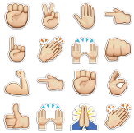
Correct
Food Services employees should ignore the gesture and report the incident to administration or supervision. Do not engage in any behaviors, either directly or indirectly with a student(s) that are unprofessional.
Food Services Employees may not make hand gestures (middle finger) of any sort to the students.
Notes:
TELL: Correct, the employees should ignore the gesture and report the incident to administration or supervision. Do not engage in any behaviors, either directly or indirectly with a student(s) that are unprofessional.Employees may not make hand gestures (middle finger) of any sort to the students. Click to continue.

Slide 47
Touch The Hand
Place your hand on top of the students hand and yell “ARE YOU STUPID, STOP ENTERING YOUR PIN”!
Is this an acceptable action?
Yes
No
Notes:
TELL: The employee should place his/her hand on top of the students hand and yell “ARE YOU STUPID, STOP ENTERING YOUR PIN”. Is this an acceptable action? Click yes or no.

Slide 48
Incorrect
The Food Services Employees may not touch or have physical contact with any student.
Notes:
TELL: Incorrect, the employees may not touch or have physical contact with any student. Click to continue.

Slide 49
Correct
The Food Services Employees may not touch, have physical contact with, or yell at a student. The employee must always remain calm and report the incident to supervision when students do not listen.
Notes:
TELL: Correct, the employees may not touch or have physical contact with any student, or yell at a student. The employee must always remain calm and report the incident to supervision when students do not listen.
Click to continue.

Slide 50
Tap Finger
Lightly tap the students hand with your finger and calmly say, “Please stop entering your pin, the computer is frozen”.
Is this an acceptable action?
Yes
No
Notes:
TELL: The employee should lightly tap the students hand with a finger and calmly say “please stop entering your pin, the computer is frozen”. Is this an acceptable action? Click yes or no.

Slide 51
Incorrect
Food Services Employees may not touch or have physical contact with any student.
Notes:
TELL: Incorrect, the employees may touch or have physical contact with any student. Click to continue.

Slide 52
Correct
The Food Services Employees can only ask the student to stop in a calm polite voice without touching or having physical contact with any student.
Notes:
TELL: Correct, the employees can only ask the student to stop in a calm polite voice without touching or having physical contact with any student.
Click to continue.

Slide 53
T-Rex Arms
Put your hands close to your body and in a calm voice tell the students, “Stop entering your pin numbers at the same time”.
Is this an acceptable action?
Yes
No
Notes:
TELL: Should the employee keep his/her hands close to themselves and in a calm and stern voice tell the students “stop entering your pins at the same time”. Is this an acceptable action? Click yes or no.

Slide 54
Incorrect
Food Services Employees MAY NOT make statements or comments that are not age appropriate and professional, or which may be considered sexual harassment in nature, either indirectly or in the presence of any student.
Notes:
TELL: Incorrect, employees MAY NOT make statements or comments that are not age appropriate and professional, or which may be considered sexual harassment in nature, either indirectly or in the presence of any student. Click to continue.

Slide 55
Correct
Food Services Employees must keep their hands to themselves and remain calm. In a low polite voice ask the students to remove their hands from the pin pads to allow CMS to work.
Notes:
TELL: Correct, the employees must keep their hands to themselves and remain calm. In a low polite voice ask the students to remove their hands from the pin pads to allow CMS to work. Click to continue.

Slide 56
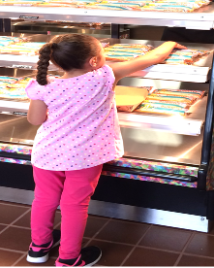
Scenario 5 – Selecting Food
The Food Services Worker assigned to work the serving line or window for lunch is replenishing the burritos for the students. The student selects the burrito in the back, instead of the burrito in the front.
Notes:
TELL: Scenario number five, selecting food. The Food Services Worker assigned to work the serving line or window for lunch is replenishing the burritos for the students. The student selects the burrito in the back, instead of the burrito in the front. How would you react?

Slide 57
Scold The Student
Scold the student with your finger pointed and yell, “you need to choose the burrito in the front you brat, hurry up!”
Is this an acceptable action?
Yes
No
Notes:
TELL: The employee should scold the student with your finger pointed and yell “you need to choose the burrito in the front you brat, hurry up”. Is this an acceptable action? Click yes or no.

Slide 58
Incorrect
Food Services Employees MAY NOT make statements or comments that are not age appropriate and professional, or which may be considered sexual harassment in nature, either indirectly or in the presence of any student.
Notes:
TELL: Incorrect, the employees MAY NOT make statements or comments that are not age appropriate and professional, or which may be considered sexual harassment in nature, either indirectly or in the presence of any student. Click to continue.

Slide 59
Correct
Food Services Employees MAY NOT make statements or comments that are not age appropriate and professional, or which may be considered sexual harassment in nature, either indirectly or in the presence of any student.
Notes:
TELL: Correct, the employees MAY NOT make statements or comments that are not age appropriate and professional, or which may be considered sexual harassment in nature, either indirectly or in the presence of any student. Click to continue.

Slide 60
Tug A War
Walk around the counter, grab the burrito from the students hand and yell, “I told you to put the burrito back, are you stupid!”
Is this an acceptable action?
Yes
No
Notes:
TELL: The employee should walk around the counter, grab the burrito from the students hand and yell “I told you to put the burrito back, are you stupid”. Is this an acceptable action? Click yes or no.

Slide 61
Incorrect
Food Services Employees MAY NOT engage in any behaviors, either directly or indirectly with a student(s) or in the presence of a student(s), that are unprofessional , unethical, illegal, immoral, or exploitative.
Notes:
TELL: Incorrect, the employees MAY NOT engage in any behaviors, either directly or indirectly with a student(s) or in the presence of a student(s), that are unprofessional , unethical, illegal, immoral, or exploitative. Click to continue.

Slide 62
Correct
Food Services Employees MAY NOT engage in any behaviors, either directly or indirectly with a student(s) or in the presence of a student(s), that are unprofessional , unethical, illegal, immoral, or exploitative.
Notes:
TELL: Correct, the employees MAY NOT engage in any behaviors, either directly or indirectly with a student(s) or in the presence of a student(s), that are unprofessional , unethical, illegal, immoral, or exploitative. Click to continue.

Slide 63
Smash/Slap The Hand
When the student reaches for the burrito in the back you hit or slap her hand.
Is this an acceptable action?
Yes
No
Notes:
TELL: When the student reaches for the burrito in the back the employee hits or slaps her hand. Is this an acceptable action? Click yes or no.

Slide 64
Incorrect
Food Services Employees may not touch or have physical contact with any student.
Notes:
TELL: Incorrect, the employees may not touch or have physical contact with any student. Click to continue.

Slide 65
Correct
Food Services Employees may not touch or have physical contact with any student.
Notes:
TELL: Correct, the employees may not touch or have physical contact with any student. Click to continue.

Slide 66
Enjoy Your Food and Smile
Smile and allow the student to select the item of their choice.
Is this an acceptable action?
Yes
No
Notes:
TELL: The employee should smile and allow the student to select the item of their choice. Is this an acceptable action? Click yes or no.

Slide 67
Correct
Food Services Employees will welcome the student to Café LA and allow the student to select food items in the front, back, bottom, or top of the service line or window area.
Notes:
TELL: Correct, the employees will welcome the student to Café LA and allow the student to select food items in the front, back, bottom, or top of the service line or window area. Click to continue.

Slide 68
Incorrect
Food Services Employees may not touch or have physical contact with any student and must be professional and courtesy to all customers who enter Café LA.
Notes:
TELL: Incorrect, the employees may not touch or have physical contact with any student and must be professional and courteous to all customers who enter Café LA. Click to continue.

Slide 69
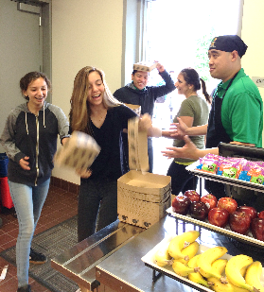
Scenario 6 - Disorganized Line
The bell rang for lunch and the students are not in a single file line. They are wild, loud, and participating in horseplay.
Notes:
TELL: Scenario six, Disorganized line. The bell rang for lunch and the students are not in a single file line. They are wild, loud, and participating in horseplay. How would you react?

Slide 70
Shove Students Into A Line
Push the students in a line and yell, “stop acting like animal, you kids belong in the zoo!”
Is this an acceptable action?
Yes
No
Notes:
TELL: The employee should push the students in a line and yell “ stop acting like animals you kids belong in the zoo”. Is this an acceptable action? Click yes or no.

Slide 71
Incorrect
Food Services Employees MAY NOT make statements or comments that are not age appropriate and professional, or which may be considered sexual harassment in nature, either indirectly or in the presence of any student.
OR
Touch or have physical contact with any student.
Notes:
TELL: Incorrect, the employees MAY NOT make statements or comments that are not age appropriate and professional, or which may be considered sexual harassment in nature, either indirectly or in the presence of any student or touch or have physical contact with any student. Click to continue.

Slide 72
Correct
Food Services Employees MAY NOT make statements or comments that are not age appropriate and professional, or which may be considered sexual harassment in nature, either indirectly or in the presence of any student.
OR
Touch or have physical contact with any student.
Notes:
TELL: Correct, the employees MAY NOT make statements or comments that are not age appropriate and professional, or which may be considered sexual harassment in nature, either indirectly or in the presence of any student or touch or have physical contact with any student. Click to continue.

Slide 73
Call For Support
Immediately call supervision or administration to handle the situation.
Is this an acceptable action?
Yes
No
Notes:
TELL: The employee should immediately call supervision or administration to handle the situation. Is this an acceptable action?
Click yes or no.

Slide 74
Correct
Immediately locate/call supervision or administration to take control of the situation.
Manager must always be present during lunch service to assist with keeping students in line.
If keeping students in line is a frequent issue the FSM must seek assistance from the principal and notify the AFSS.
Notes:
TELL: Correct, immediately locate/call supervision or administration to take control of the situation.
Manager must always be present during lunch service to assist with keeping students in line.
If keeping students in line is a frequent issue the FSM must seek assistance from the principal and notify the AFSS. If keeping students in line is a frequent issue the FSM must seek assistance from the principal and notify the AFSS. Click to continue.

Slide 75
Incorrect
Food Services Employees MAY NOT engage in any behaviors, either directly or indirectly with a student(s) or in the presence of a student(s), that are unprofessional , unethical, illegal, immoral, or exploitative.
Notes:
TELL: Incorrect, the employee MAY NOT engage in any behaviors, either directly or indirectly with a student(s) or in the presence of a student(s), that are unprofessional , unethical, illegal, immoral, or exploitative. Click to continue.

Slide 76
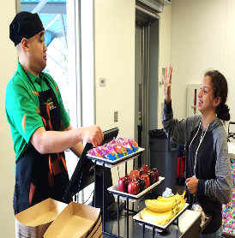
Scenario 7 – Student Throws Food
A student selects a non reimbursable meal. The employee instructs the student to select a vegetable or fruit. The student grabs the baby carrot and says “are you happy now, a__hole!” and throws the carrots at the employee.
Notes:
TELL: Scenario seven. A student select a non reimbursable meal. The employee instructs the student to select a vegetable or fruit. The student grabs the baby carrots and says “are you happy now, a__hole!” and throws the carrots at the employee. How would you react?

Slide 77
Employee Throws Food At Student
The employee picks up another bag of baby carrots and throws the carrots at the student.
Is this an acceptable action?
Yes
No
Notes:
TELL: The employee should pick up another bag of baby carrots and throws the carrots at the student.
Is this an acceptable action? Click yes or no.

Slide 78
Incorrect
Food Services Employees MAY NOT engage in any behaviors, either directly or indirectly with a student(s) or in the presence of a student(s), that are unprofessional, unethical, illegal, immoral, or exploitative.
Notes:
TELL: Incorrect, the employees MAY NOT engage in any behaviors, either directly or indirectly with a student(s) or in the presence of a student(s), that are unprofessional , unethical, illegal, immoral, or exploitative. Click to continue.

Slide 79
Correct
Food Services Employees MAY NOT engage in any behaviors, either directly or indirectly with a student(s) or in the presence of a student(s), that are unprofessional, unethical, illegal, immoral, or exploitative.
Notes:
TELL: Correct, the employees MAY NOT engage in any behaviors, either directly or indirectly with a student(s) or in the presence of a student(s), that are unprofessional , unethical, illegal, immoral, or exploitative. Click to continue.

Slide 80
Attack The Student
Grab and shake the student by the arms and scream “do not throw food at me”!
Is this an acceptable action?
Yes
No
Notes:
TELL: Should the employee grab and shake the student by the arms and scream “do not throw food at me”. Is this an acceptable action? Click yes or no.

Slide 81
Incorrect
Food Services Employees may not touch, have physical contact, or yell at any student.
Notes:
TELL: Incorrect, the employee may not touch, have physical contact, or yell at any student. Click to continue.

Slide 82
Correct
Food Services Employees may not touch, have physical contact, or yell at any student.
Notes:
TELL: Correct, the employee may not touch, have physical contact, or yell at any student. Click to continue.

Slide 83
Report The Incident
Immediately call supervision or an administrator to handle the situation.
Is this an acceptable action?
Yes
No
Notes:
TELL: The employee should immediately call supervision or administration to handle the situation. Is this an acceptable action?
Click yes or no.

Slide 84
Correct
Immediately locate/call supervision or administration to take control of the situation.
Manager must always be present during lunch service to assist with keeping students in line.
If keeping students in line is a frequent issue the FSM must seek assistance from the principal and notify the AFSS.
Notes:
TELL: Correct, immediately locate/call supervision or administration to take control of the situation.
Manager must always be present during lunch service to assist with keeping students in line.
If keeping students in line is a frequent issue the FSM must seek assistance from the principal and notify the AFSS. Click to continue.

Slide 85
Incorrect
Food Services Employees will not take matters into their own hands. Do not reprimand, scream, touch students or hold the service line until supervision gets there.
Notes:
TELL: Incorrect, the employees will not take matters into their own hands. Do not reprimand, scream, touch students or hold the service line until supervision gets there.

Slide 86
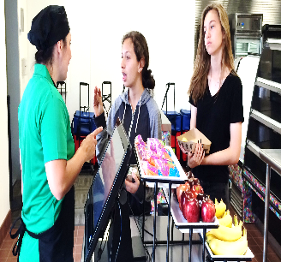
Scenario 8 – Name Calling
You are serving the line for lunch and a student says “you’re slow, you move like a turtle, b____!” and laughs.
Notes:
TELL: Scenario number eight, name calling. You are serving the line for lunch and a student says “you’re slow, you move like a turtle, b____” and laughs (ha,ha,ha). How would you react?

Slide 87
Argument
Tell the student “shut your mouth, didn’t your parents teach you any manners” and the student continues to argue with you.
Is this an acceptable action?
Yes
No
Notes:
TELL: The employee should tell the student “shut your mouth, didn’t your parents teach you any manners” and the student continues to argue with the employee. Is this an acceptable action? Click yes or no.

Slide 88
Incorrect
Food Services Employees MAY NOT make statements or comments that are not age appropriate and professional, or which may be considered sexual harassment in nature, either indirectly or in the presence of any student.
Notes:
TELL: Incorrect, the employee MAY NOT make statements or comments that are not age appropriate and professional, or which may be considered sexual harassment in nature, either indirectly or in the presence of any student. Click to continue.

Slide 89
Correct
The worker may politely tell a student once, “that was inappropriate” and serve the student a meal. Record the student’s name and report the incident to the FSM and school administrator.
Notes:
TELL: Correct, the worker may politely tell a student once, “that was inappropriate” and serve the student a meal. Record the student’s name and report the incident to the FSM and school administrator. Remember, employees MAY NOT make statements or comments that are not age appropriate and professional, or which may be considered sexual harassment in nature, either indirectly or in the presence of any student. Click to continue.

Slide 90
Slap The Student
Slap the student’s mouth or face for disrespecting you.
Is this an acceptable action?
Yes
No
Notes:
TELL: Should the employee slap the student’s mouth or face for disrespecting you. Is this an acceptable action? Click yes or no.

Slide 91
Incorrect
The Food Services Employees may not touch or have physical contact with any student.
Notes:
TELL: Incorrect, the employees may not touch or have physical contact with any student. Click to continue.

Slide 92
Correct
The Food Services Employees may not touch or have physical contact with any student.
Notes:
TELL: Correct, the employee may not touch or have physical contact with any student. Click to continue.

Slide 93
Ignore The Remark
Ignore the remark the student made, and tell the student to enjoy their meal.
Is this an acceptable action?
Yes
No
Notes:
TELL: The employee should ignore the remark the student made and tell them to enjoy their meal. Is this an acceptable action? Click yes or no.

Slide 94
Correct
The Food Services Employees will stay calm and not acknowledge the remark the student made.
Remember remain professional at all times.
Notes:
TELL: Correct, the employee will stay calm and not acknowledge the remark the student made. Remember remain professional at all times. The employee may tell the student that comment was inappropriate. Click to continue.

Slide 95
Incorrect
Food Services Employees MAY NOT make statements or comments that are not age appropriate and professional, or which may be considered sexual harassment in nature, either indirectly or in the presence of any student.
Notes:
TELL: Incorrect, the employee MAY NOT make statements or comments that are not age appropriate and professional, or which may be considered sexual harassment in nature, either indirectly or in the presence of any student. Click to continue.

Slide 96
Grace Under Pressure
The term “Grace Under Pressure” refers to the behavior of a person who is under a lot of pressure.
For example, you are the Food Services Manager of a team and you've got a deadline to meet, grace under pressure means you don't stomp around the cafeteria yelling at your staff or customers, pulling your hair out, swearing, or going crazy.
It means you retain a calm outward appearance and remain polite when dealing with people.
Notes:
TELL: The term “Grace Under Pressure” refers to the behavior of a person who is under a lot of pressure. For example, you are the Food Services Manager of a team and you've got a deadline to meet, grace under pressure means you don't stomp around the office yelling at your staff or customers, pulling your hair out, sweating, or going crazy. Grace under pressure means you retain a calm outward appearance and remain polite when dealing with people.

Slide 97
Practice Grace Under Pressure
Displaying grace under pressure is all about staying calm and mature in stressful or problematic situations
Suggestions on how to practice grace under pressure:
Lead by example
Take a deep breath
Think positively
Be proactive
Focus on the big picture
Notes:
TELL: Practicing grace under pressure is all about staying calm and mature in stressful or problematic situations. Acting emotionally or panicking is a more natural reaction to bad situations, but grace under pressure takes focus and control. Here are a few suggestions for how to practice grace under pressure, lead by example, take a deep breath, think positively, be proactive, step back and look at the big picture.

Slide 98
Self-Control
There are so many things in life that we simply cannot control, but as human beings, we have the power of reasoning and choice, both of which give us significant control over our own life situations.
Remember you can not control other peoples actions but you have complete control of your own reactions.
Notes:
TELL: There are so many things in life that we simply cannot control, but as human beings, we have the power of reasoning and choice, both of which give us significant control over our own life situations.
Remember you can not control other peoples actions but you have complete control of your own reactions.

Slide 99
References
http://ethics.lausd.net/
http://ethics.lausd.net/FTP/Employee_Code_of_Ethics.pdf
Code of Conduct with Students
LAUSD Food Services Division Employee Handbook
Notes:
TELL: The following references are great resources for additional information.

Slide 100
Questions?
Thank you!
LAUSD Food Services Division
Nourishing Children to Achieve Excellence
Notes:
TELL: Thank you for attending the proper conduct to provide excellent training.

